Slide 1

Capstone Project- 2
Seoul Bike Sharing Demand Prediction
Team Members ArunTeja Lonka
Zunaid Upasana Kumari
Sukesh Shetty

Slide 2








Introduction
Problem statement & Key objectives we are focusing on
Exploratory Data Analysis
Analysing numerical variables and Feature Processing
Model development using different algorithms
Model Performance
Challenges Faced
Results & Conclusions

Slide 3
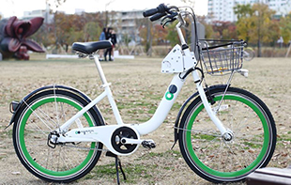
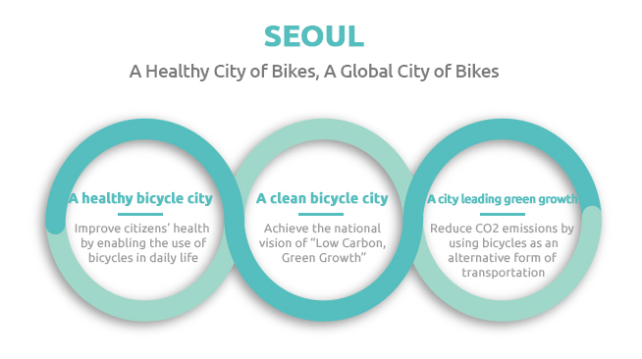
Introduction to Seoul Public Bike
Seoul Public Bike
Seoul Public Bikes are designed to be used by all including women, the elderly and the infirm. Made of light-weight and durable materials, the bicycles prioritize driving stability and user convenience.

Slide 4

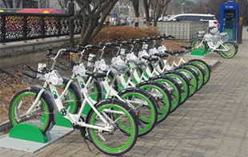
Introduction to Seoul Public Bike
Rental Stations
Rental stations are installed by popular pedestrian areas, including subway entrances/exits, bus stops, residential complexes, public offices, schools, and banks.
Rental stations are unmanned stands for the rental and return of bikes.
Rental stations are installed in highly accessible areas near popular destinations.
Users can rent and return bicycles at any rental station.
Docking Station
A docking station is a facility for parking bicycles. It has a lock that binds to the bicycle upon return.
When renting a bicycle, separate the lock that is connected to the docking station from the bike terminal.

Slide 5


Problem statement ..
Problem Description
Currently Rental bikes are introduced in many urban cities for the enhancement of mobility comfort. It is important to make the rental bike available and accessible to the public at the right time as it lessens the waiting time. Eventually, providing the city with a stable supply of rental bikes becomes a major concern. The crucial part is the prediction of bike count required at each hour for the stable supply of rental bikes.
The main goal is to create a prediction model that can be used to anticipate the number of bike rentals each hour based on weather conditions. As a result, it would be easier to anticipate fast and accurately.

Slide 6
Data Description
The dataset contains weather information (Temperature, Humidity, Windspeed, Visibility, Dewpoint, Solar radiation, Snowfall, Rainfall), the number of bikes rented per hour and date information.
Attribute Information:
Date : year-month-day
Rented Bike count - Count of bikes rented at each hour
Hour - Hour of the day
Temperature-Temperature in Celsius
Humidity - %
Windspeed - m/s
Visibility - 10m
Dew point temperature - Celsius
Solar radiation - MJ/m2
Rainfall - mm Snowfall - cm
Seasons - Winter, Spring, Summer, Autumn
Holiday - Holiday/No holiday
Functional Day - NoFunc(Non Functional Hours), Fun(Functional hours)
This Dataset contains 8760 lines and 14 columns.
In a day we have 24 hours and we have 365 days a year so 365 multiplied by 24 = 8760, which represents the number of line in the dataset.*

Slide 7
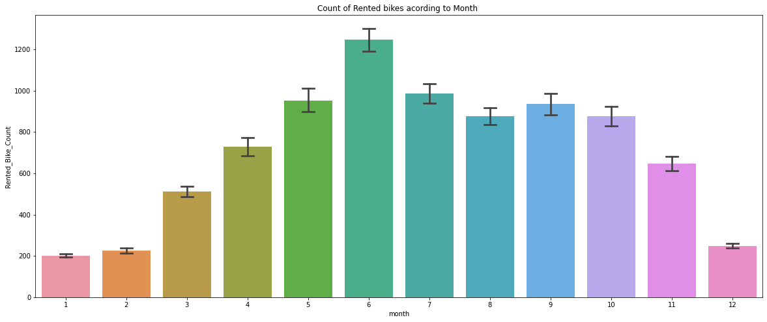
Exploratory Data Analysis(EDA)
An EDA is a thorough examination meant to uncover the underlying structure of a data set and is important for a company because it exposes trends, patterns, and relationships that are not readily apparent.

Slide 8
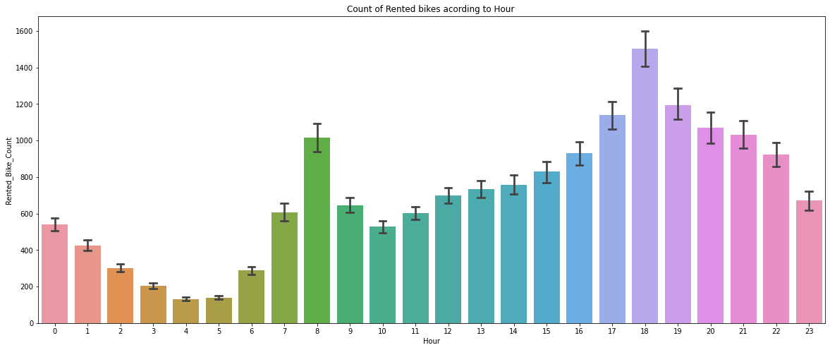
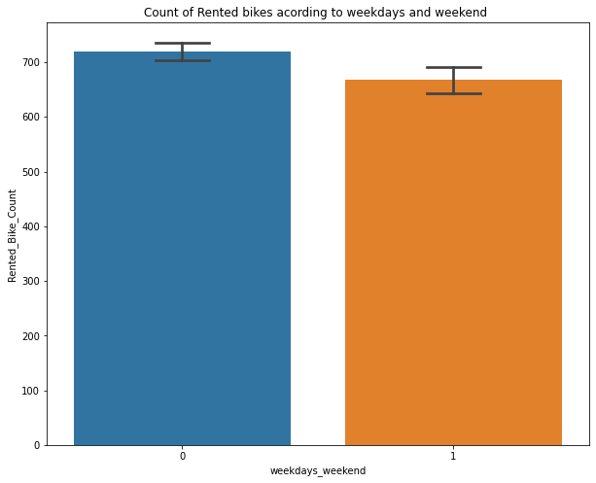
Exploratory Data Analysis(EDA)

Slide 9
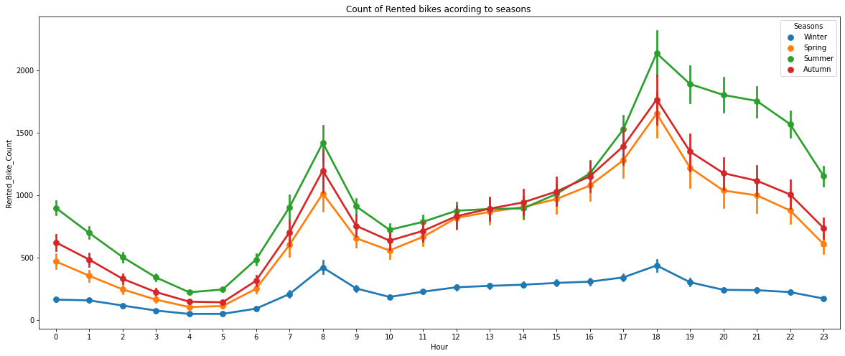
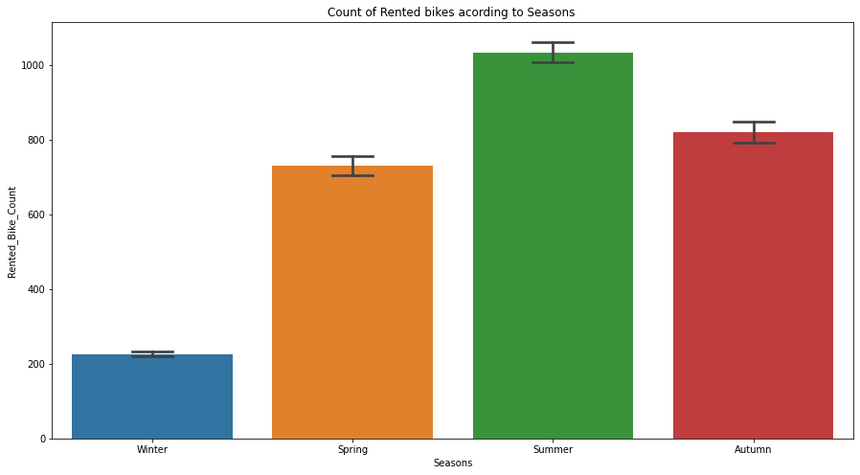
In the above bar plot and point plot which shows the use of rented bike in in four different seasons, and it clearly shows that,
In summer season the use of rented bike is high and peak time is 7am-9am and 7pm-5pm.
In winter season the use of rented bike is very low because of snowfall.

Slide 10
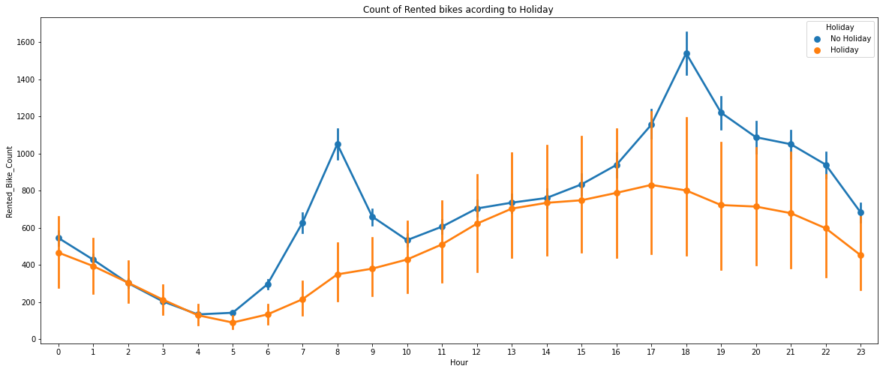
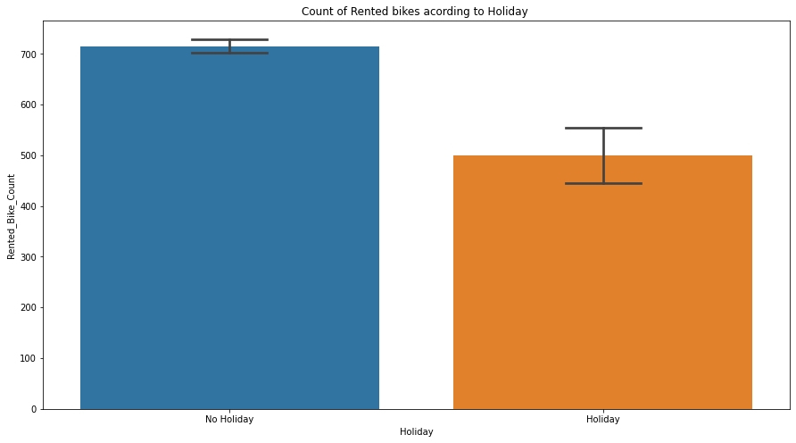
Exploratory Data Analysis(EDA)
In the above bar plot and point plot which shows the use of rented bike in a holiday, and it clearly shows that,
plot shows that in holiday people uses the rented bike from 2pm-8pm

Slide 11
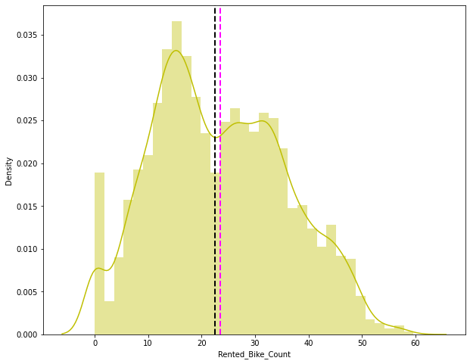
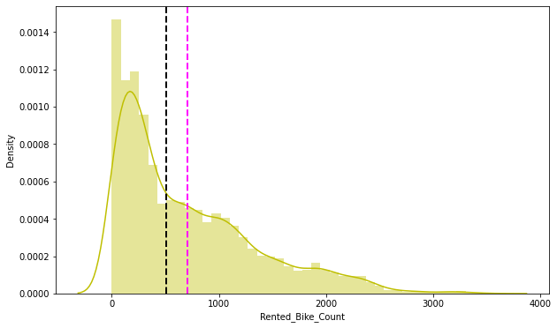
Analysing numerical variables and Feature Processing
distribution of dependent variable
The above graph shows that Rented Bike Count has moderate right skewness. Since the assumption of linear regression is that 'the distribution of dependent variable has to be normal', so we should perform some operation to make it normal.
Since we have generic rule of applying Square root for the skewed variable in order to make it normal .After applying Square root to the skewed Rented Bike Count, here we get almost normal distribution.

Slide 12
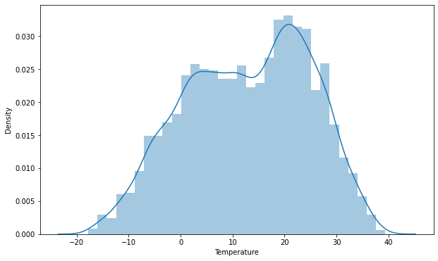
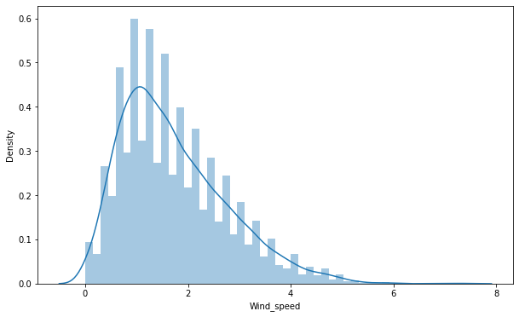
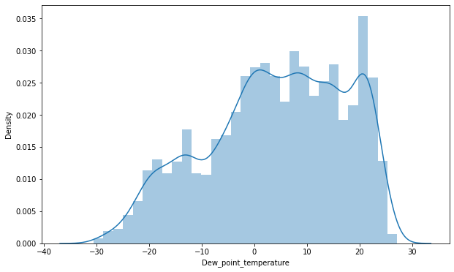
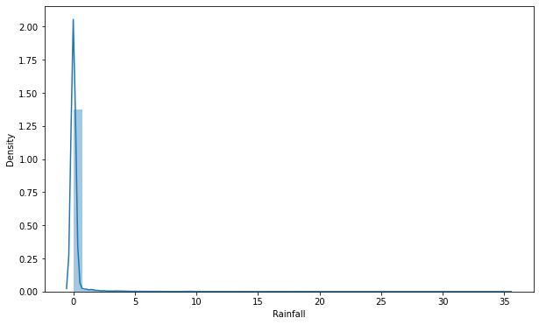
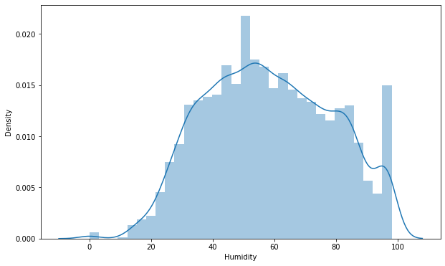
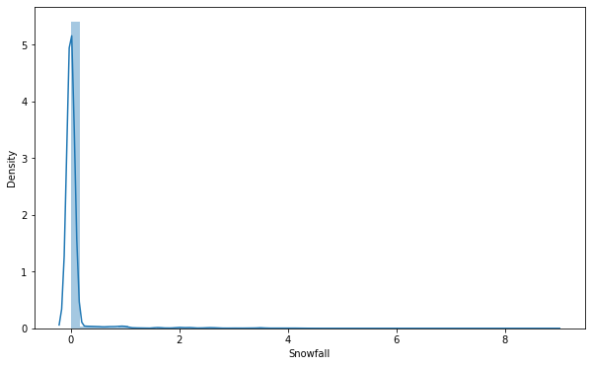
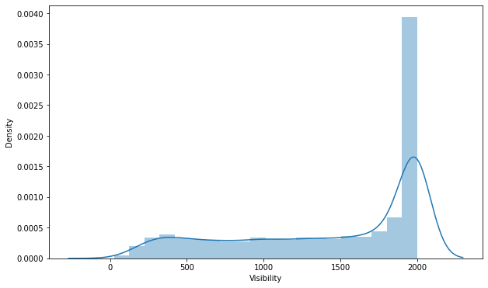
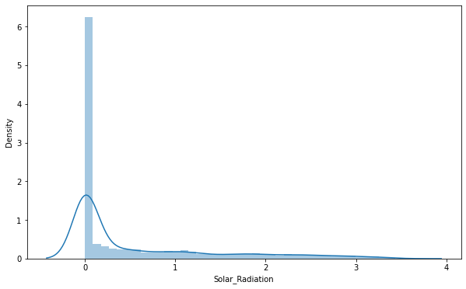
Distribution of our Independent Variable

Slide 13
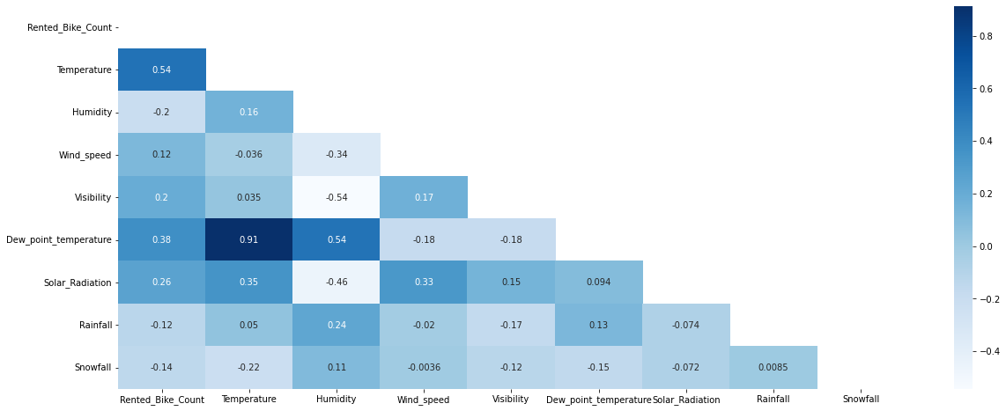
correletion betweeen variables using Correlation heatmap
We can observe on the heatmap that on the target variable line the most positively correlated variables to the rent are :
the temperature
the dew point temperature
the solar radiation
And most negatively correlated variables are:
Humidity
Rainfall
From the above correlation heatmap, We see that there is a positive correlation between columns 'Temperature' and 'Dew point temperature' i.e. 0.91 so even if we drop this column then it don't affects the outcome of our analysis. And they have the same variations.. so we can drop the column 'Dew point temperature(°C)'.

Slide 14
Label Encoding:
A dataset may contain various type of values, sometimes it consists of categorical values. So, in-order to use those categorical value for programming efficiently we create dummy variables.
one hot encoding
A one hot encoding allows the representation of categorical data to be more expressive. Many machine learning algorithms cannot work with categorical data directly.
The categories must be converted into numbers.
This is required for both input and output variables that are categorical.
##Example function def one_hot_encoding(data, column):
data = pd.concat([data, pd.get_dummies(data[column], prefix=column, drop_first=True)], axis=1)
data = data.drop([column], axis=1)
return data

Slide 15
Model development using different algorithms
we implemented 7 machine learning algorithms
Linear regression
Lasso regression
Ridge regression
Elastic net regression
Decision tree regression
Random forest regression
Gradient boosting regression
Gradient Boosting GridsearchCV

Slide 16
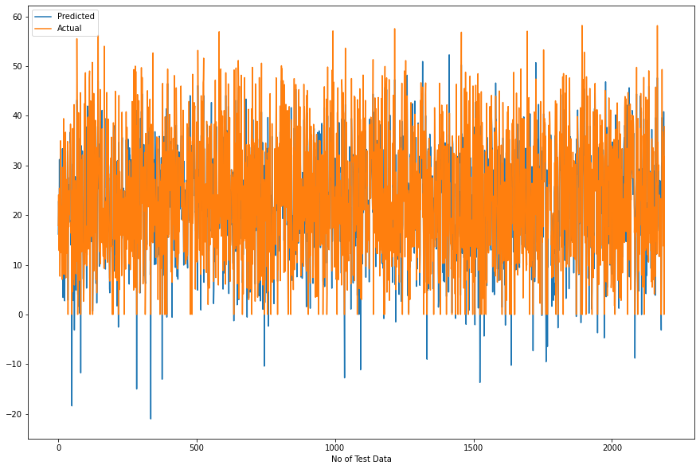
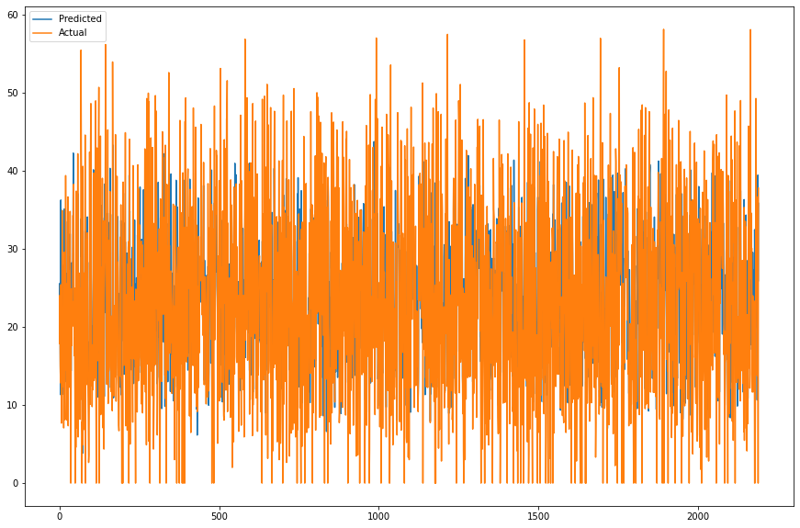
LINEAR REGRESSION
LASSO REGRESSION
Train set results:
MSE : 35.07751288189293 RMSE : 5.9226271942350825 MAE : 4.474024092996787
R2 : 0.7722101548255267 Adjusted R2 : 0.7672119649454145
Test set results:
MSE : 33.27533089591926 RMSE : 5.76847734639907 MAE : 4.410178475318181 R2 : 0.7893518482962683 Adjusted R2 : 0.7847297833429184
MSE : 96.7750714044618 RMSE 9.837432155011886 MAE :7.455895061963607 R2 :0.3873692800799008 Adjusted R2 : 0.37392686932535146
MSE : 91.59423336097032 RMSE :9.570487623991283
MAE : 7.255041571454952
R2 :0.40519624904934015 Adjusted R2 : 0.3921449996120475

Slide 17
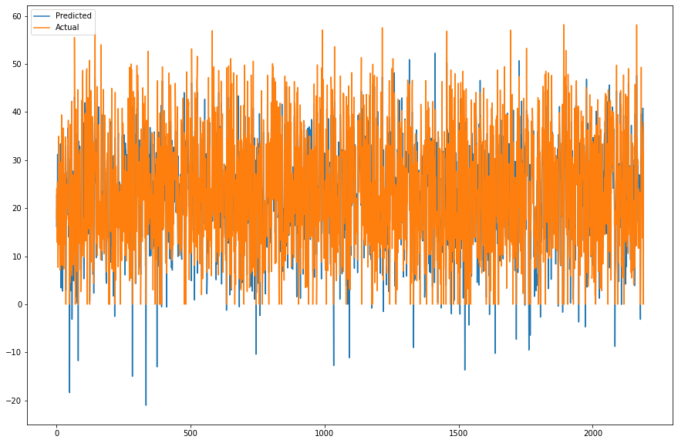
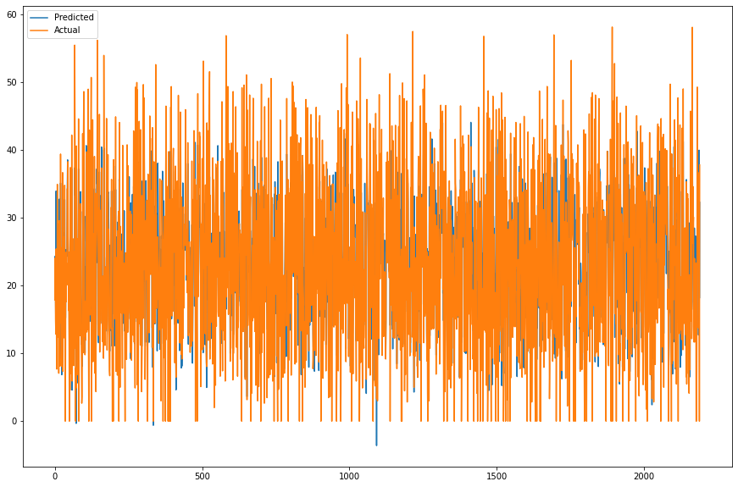
RIDGE REGRESSION
ELASTIC NET REGRESSION
Train set results:
MSE : 35.07752456136463
RMSE : 5.922628180239296
MAE : 4.474125776125378
R2 : 0.7722100789802107
Adjusted R2 : 0.7672118879
Test set results:
MSE : 33.27678426818438
RMSE : 5.768603320404722
MAE : 4.410414932539515
R2 : 0.7893426477812578
Adjusted R2 : 0.784720389
Train set results:
MSE : 57.5742035398887
RMSE : 7.587766703048315
MAE : 5.792276538970546
R2 : 0.6261189054494012
Adjusted R2 : 0.6179151652
Test set results:
MSE : 59.45120536350042
RMSE : 7.710460774538
MAE : 5.873612334800099
R2 : 0.62364652169
Adjusted R2 : 0.6153885321

Slide 18
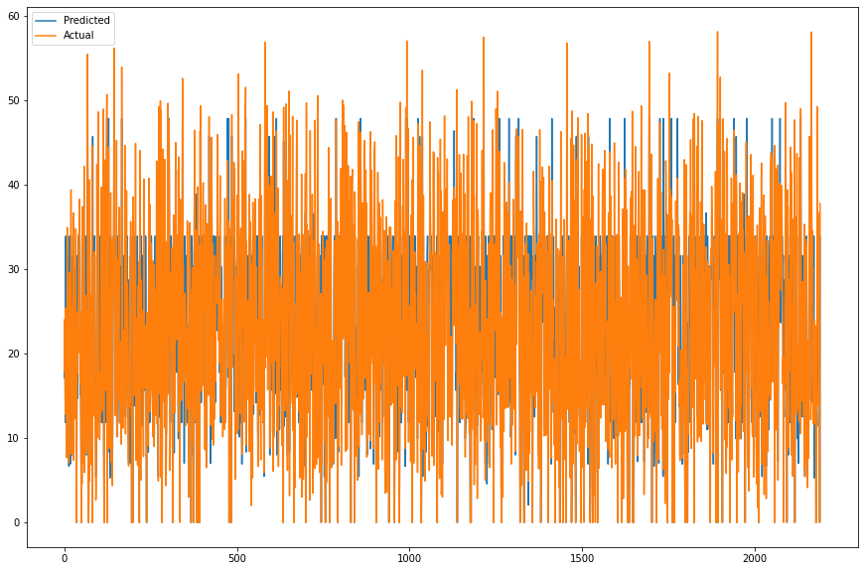
DECISION TREE
RANDOM FOREST
Train set results:
MSE : 43.47944139910931
RMSE : 6.593894251435135
MAE : 4.833796381744261
R2 : 0.7176488749951184
Adjusted R2 : 0.7114534955015472
Train set results:
MSE : 1.5776988364569622
RMSE : 1.2560648217576043
MAE : 0.7983299095968202
R2 : 0.9897545822333945
Adjusted R2 : 0.9895297761479461
Test set results:
MSE : 50.424498696751435
RMSE : 7.101020961576682
MAE : 5.196762423651914
R2 : 0.6807897272522531
Adjusted R2 : 0.6737855802778627
Test set results:
MSE : 12.685885000312213
RMSE : 3.561725003465626
MAE : 2.2077215853951526
R2 : 0.9196925122577947
Adjusted R2 : 0.9179303965136847

Slide 19
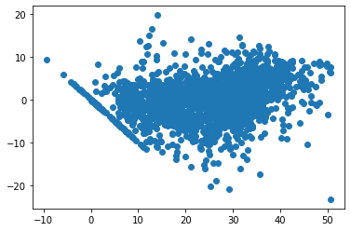
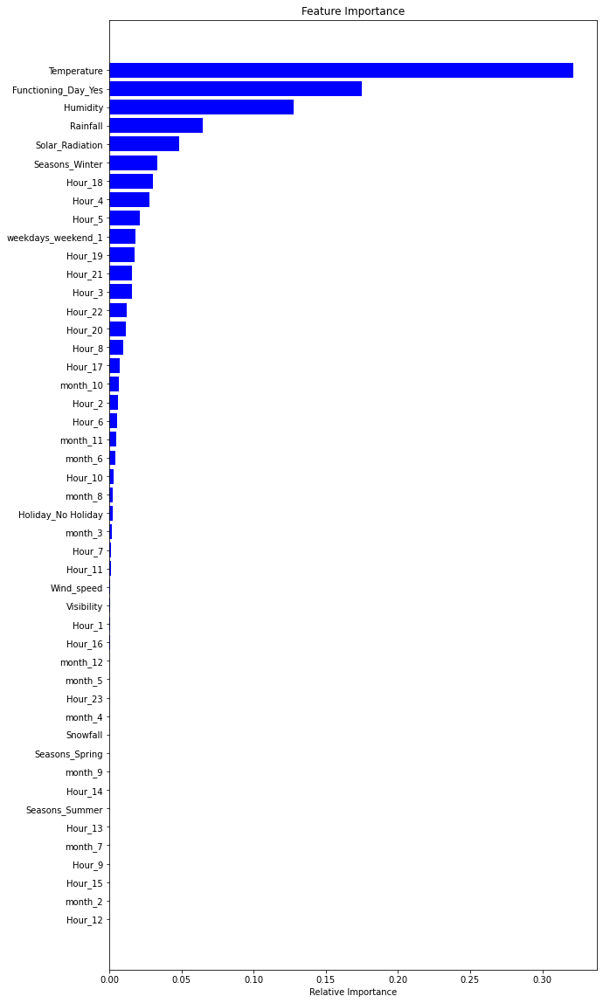
GRADIENT BOOSTING
Train set result:
MSE : 18.64801713184794
RMSE : 4.3183349953249275
MAE : 3.269003569273124
R2 : 0.8789016499095264
Adjusted R2 : 0.8762444965695393
Feature Feature Importance
0 Temperature 0.31
1 Humidity 0.15
2 Windspeed 0.01
3 Visibility 0.01
4 Solar_Radiatio 0.04
Test set results:
MSE : 21.28944184250869
RMSE : 4.6140483138463875
MAE : 3.492858786559991
R2 : 0.8652280396863458
Adjusted R2 : 0.8622708584843188

Slide 20

Conclusions:
Hour of the day holds the most important feature.
Bike rental count is mostly correlated with the time of the day as it is peak at 10am morning and 8pm at evening
We observed that bike rental count is high during working days than non-working days.
We see that people generally prefer to rent bike at moderate to high temperatures, and when little windy
It is observed that highest number bike rentals counts in Autumn & Summer seasons and the lowest in winter season.
We observed that the highest number of bike rentals on a clear day and the lowest on a snowy or rainy day.
We observed that with increasing humidity, the number of bike rental counts decreases.

Slide 21
Results & Conclusions:
During the time of our analysis, we initially did EDA on all the features of our dataset.
We first analysed our dependent variable, 'Rented Bike Count' and also transformed it.
Next we analysed categorical variable and dropped the variable who had majority of one class, we also analysed numerical variable, found out the correlation, distribution and their relationship with the dependent variable.
We also removed some numerical features who had mostly 0 values and hot encoded the categorical variables.
Next we implemented 7 machine learning algorithms Linear Regression, lasso, ridge, elastic net, decision tree, Random Forest and XGBoost.
We did hyperparameter tuning to improve our model performance.
The results of our evaluation are:

Slide 22

Training set Results:
 |  | Model | MAE | MSE | RMSE | R2_score | Adjusted R2
Training set | 0 | Linear regression | 4.474 | 35.078 | 5.923 | 0.772 | 0.77
 | 1 | Lasso regression | 7.255 | 91.594 | 9.570 | 0.405 | 0.39
 | 2 | Ridge regression | 4.474 | 35.078 | 5.923 | 0.772 | 0.77
 | 3 | Elastic net regression | 5.792 | 57.574 | 7.588 | 0.626 | 0.62
 | 4 | Dicision tree regression | 5.716 | 56.456 | 7.514 | 0.633 | 0.63
 | 5 | Random forest regression | 0.805 | 1.592 | 1.262 | 0.990 | 0.99
 | 6 | Gradient boosting regression | 3.269 | 18.648 | 4.318 | 0.879 | 0.88
 | 7 | Gradient Boosting gridsearchcv | 1.849 | 7.455 | 2.730 | 0.952 | 0.95

Slide 23
Test set Results
Model | MAE | MSE | RMSE | R2_score | Adjusted R2
Test set | 0 | Linear regression | 4.410 | 33.275 | 5.768 | 0.789 | 0.78
 | 1 | Lasso regression | 7.456 | 96.775 | 9.837 | 0.387 | 0.37
 | 2 | Ridge regression | 4.410 | 33.277 | 5.769 | 0.789 | 0.78
 | 3 | Elastic net regression Test | 5.874 | 59.451 | 7.710 | 0.624 | 0.62
 | 4 | Decision tree regression | 5.872 | 60.654 | 7.788 | 0.616 | 0.61
 | 5 | Random forest regression | 2.211 | 12.761 | 3.572 | 0.919 | 0.92
 | 6 | Gradient boosting regression | 3.493 | 21.289 | 4.614 | 0.865 | 0.86
 | 7 | Gradient Boosting gridsearchcv | 2.401 | 12.393 | 3.520 | 0.922 | 0.92

Slide 24

Results & Conclusions:
No overfitting is seen.
Random forest Regressor and Gradient Boosting gridsearchcv gives the highest R2 score of 99% and 95% respectively for Train Set and 92% for Test set.
Feature Importance value for Random Forest and Gradient Boost are different.
We can deploy this model.
However, this is not the ultimate end. As this data is time dependent, the values for variables like temperature, windspeed, solar radiation etc., will not always be consistent. Therefore, there will be scenarios where the model might not perform well.
As Machine learning is an exponentially evolving field, we will have to be prepared for all contingencies and also keep checking our model from time to time.
Therefore, having a quality knowledge and keeping pace with the ever evolving ML field would surely help one to stay a step ahead in future.

Slide 25


Challenges Faced
Understanding Problem Statement
Reading the dataset and Understanding the meaning of some columns
Designing multiple visualisations to summarize the information in the dataset and successfully communicate the results and trends to clints/readers
Machine learning models usually required high computation power

Slide 26

Refences and links
Alma better
analytics Vidhya
Kaggle
Quora
Stack over flow
Git hub link:https://github.com/AruntejaLonka/Bike-Sharing-Demand-Prediction
Google Drive link:https://drive.google.com/drive/folders/1Cinv-BQ1ATgreUb0md0b28L4ojguwFxR?usp=sharing

